Slide 1
Fit to Finish Modeling
John Mount, Win Vector LLC

Slide 2

Introduction
I am a Principal Consultant at Win Vector LLC. I have a Ph.D in computer science from Carnegie Mellon University, using probabilistic methods to prove convergence rates of Markov chains in optimization and sampling applications.
Co-author Practical Data Science with R
Co-author of several R packages
vtreat
wrapr
cdata
WVPlots
Co-author of several Python data science packages
vtreat
data_algebra
wvpy
Notes:
I worked on structural diversity of molecules for biotech applications, wrote and executed algorithmic trading strategies for Banc of America securities (a division of Bank of America). I am now concentrating on data science, machine learning, AI and analytics consulting and teaching. My most recent teaching product is a two week private immersion course on data science for engineers.

Slide 3
Fit to Finish Modeling
There is a tension between statistics and data science.
Statistics emphasizes model identification and inference.
Data Science emphasizes quality of model predictions.
Either field can be made to look bad by judging it in terms of the other’s concerns.
I will show what it looks like to rush from data to building a model predictive model (supervised machine learning).
Notes:
Machine learning practice, often called data science, emphasizes empirical tuning of predictive models. When these practitioners run into common problems they propose and promote fixes somewhat different than the statistical canon. I’ll discuss two issues where data science practice differs from statistical inference: co-linear variables and building classifiers for un-balanced models. For co-linear variables the data science practice is often “regularize and ignore”, which I will define and explain why this fire and forget procedure seems to work. This lets us start to explore the consequences of using prediction quality as an exclusive model quality metric. For un-balanced models I argue that the result is the opposite: ignoring the internal probabilistic structure of the problem leads to unnecessarily clumsy work-arounds.

Slide 4
Supervised Machine Learning
The task data scientist tend to be interested in is “supervised machine learning.”
You are shown a table with rows of the form (X, y): try to find a function that that f(X) ~ y.
Examples:
Predicting children’s height from parent’s height.
Predicting cancer risk.
Predicting the probabilty of clicking on an online advertisement.
(tends to ignore issues of cause!)

Slide 5
Problems and Practices
defensive ritual | fear
variable pruning | over-fit
variable pruning | co-linear variables
regularization | over-fit
regularization | co-linear variables
re-weighting data | unbalanced classification classes
re-weighting data | heteroskedastic errors
re-weighting data | concept drift
non-linear outcome transforms | heteroskedastic errors
Data scientists and statisticians both have fears and protective wards. Unless you are doing cargo cult science the two have a relation. Some of the relations are illustrated here.

Slide 6
This Talk
In this talk I’ll discuss predictive modeling and some classic “bugbears”:
co-linear variables
unbalanced classification classes
This is a chance to review some “street fighting statistics in R.”
All slides and material here: https://github.com/WinVector/Examples/tree/main/Fit_to_Finish_Modeling.

Slide 7
Co-Linear Variables

Slide 8
Co-Linear Variables, some data
family | father | mother | gender | height | kids | male | female | mid_parent
1 | 78.5 | 67.0 | M | 73.2 | 4 | 1 | 0 | 150.86
1 | 78.5 | 67.0 | F | 69.2 | 4 | 0 | 1 | 150.86
1 | 78.5 | 67.0 | F | 69.0 | 4 | 0 | 1 | 150.86
1 | 78.5 | 67.0 | F | 69.0 | 4 | 0 | 1 | 150.86
2 | 75.5 | 66.5 | M | 73.5 | 4 | 1 | 0 | 147.32
2 | 75.5 | 66.5 | M | 72.5 | 4 | 1 | 0 | 147.32
Consider the following famous data set, Galton’s height data. Galton didn’t start with multi-variate regression, so he introduced a variable called “mid_parent”.
d <- read.table( "galton-stata11.tab", header = TRUE) d$mid_parent = ( d$father + 1.08 * d$mother) knitr::kable(head(d))

Slide 9
Held Out Evaluation
In deployment or production most data we see was not available when the model was trained! We try to simulate this for our evaluation by using held-out data.
# build a per-family test/train split families <- unique(d$family) train_families <- sample( families, size = 0.8 * length(families), replace = FALSE) d_train <- d[d$family %in% train_families, ] d_test <- d[!(d$family %in% train_families), ]

Slide 10
A Model
 | Estimate | Std. Error | t value | Pr(>|t|)
(Intercept) | 17.9561672 | 4.7285528 | 3.797392 | 0.0001589
father | 0.3829092 | 0.0499156 | 7.671133 | 0.0000000
mother | 0.3490361 | 0.0553181 | 6.309615 | 0.0000000
Here is a standard model, notice mid_parent is suppressed as it is co-linear with some combination of father and mother.
# standard OLS model model_1 <- lm( height ~ father + mother + mid_parent, data = d_train) knitr::kable( summary(model_1)$coefficients )

Slide 11
Another Model
 | s0
father | 0.3961184
mother | 0.3633321
mid_parent | -0.0132192
# L2 regularized model var_cols <- c( "father", "mother", "mid_parent") model_2 <- glmnet::glmnet( x = as.matrix( d_train[ , var_cols]), y = d_train[["height"]], alpha = 0, lambda = 1e-3) knitr::kable( as.matrix(model_2$beta) )

Slide 12
How effectively different are the models?
Indistinguishable.
preds_1 <- predict(model_1, newdata = d_test) sqrt(mean((d_test[["height"]] - preds_1)^2))
[1] 3.383145
preds_2 <- as.numeric( predict(model_2, as.matrix( d_test[ , var_cols]))) sqrt(mean((d_test[["height"]] - preds_2)^2))
[1] 3.383153
sqrt(mean((preds_1 - preds_2)^2))
[1] 4.802859e-05

Slide 13
How semantically different are the models?
Very Different.
The traditional model has made the decision to suppress mid_parent.
This means the model is immune to any harm this variable could inflict in the future. Say for example some day in the future it is calculated or stored wrong in our data source.
Actually a super important decision, perhaps best left to the practitioner to decide which of father, mother, or mid_parent should be dropped.
The L2 regularized (or Ridge Regression or Tikhonov Regularized) model keeps all variables, but tries to enforce small (near zero) coefficients.
This is a “fire and forget strategy.”
Works well if the average of the variables is more stable than the individual variables, as it often is.

Slide 14
The Fit to Finish Dilemma
Machine learning or AI-training builds a model that is superficially indistinguishable from a correct model.
Often best possible on training data. In the absence of over-fit issues may be nearly best possible on hold out data.
The statistics view
May still be the wrong model, with wrong coefficients inferred.
Model identification is important, as the model may be called on an example not similar to the training data.
The data science view
“I am paid to call predict(), we are done here.”
For many business situations, this is in fact the right answer!
Model identification is pointless, as we can’t expect reliable predictions on examples not distributionally similar to the training data.

Slide 15
Unbalanced Classification Classes

Slide 16
Tools deforming the hands
Data scientist over-worry about unbalanced classes in classification problems.
This distinction is a bit stronger in the Python data science community as the Python sklearn .predict() interface returns class labels instead of links or probabilities.
The R predict() interface doesn’t have this issue.

Slide 17
A Classification Example
For our classification example, let’s take a BCSC breast cancer data set.
For this model breast_cancer_history codes to 0 (no cancer), or 1 (cancer) for all instances with known cancer status. Each row is weighted by how many examples like the given row are in a larger ideal data set.
d_orig <- read.csv( "bcsc_risk_factors_summarized1_092020.csv.gz") d <- d_orig[d_orig$breast_cancer_history %in% c(0, 1), ] sum(d["breast_cancer_history"] * d["count"]) / sum(d["count"])
[1] 0.1034583
The prevalence of cancer, among those instances with known cancer determination, is about 10.3%.

Slide 18
Preparing the data
All the variables in this model are re-coded categoricals, so we need to force them to be treated as strings.
vars <- c( "year", "age_group_5_years", "race_eth", "first_degree_hx", "age_menarche", "age_first_birth", "BIRADS_breast_density", "current_hrt", "menopaus", "bmi_group", "biophx") for(v in vars) { d[v] <- as.character(d[[v]]) }

Slide 19
Building a classification model
We can fit a logistic regression classification model on this data.
env <- environment() # so glm() can find weights! model <- glm( wrapr::mk_formula( "breast_cancer_history", vars, env = env), data = d, family = binomial(link = "logit"), weights = d[["count"]])

Slide 20
Using the model
Let’s see what sort of cancer risk the model associates with each of our example situations.
predict(model, newdata = d, type="response")[1: 3]
1 2 3 0.006407362 0.109373072 0.006369305
Remember each outcome we are trying to match is 0 or 1 (and each row in the data set can represent multiple individuals).
table(d[["breast_cancer_history"]])
0 1 304802 80400

Slide 21
Probabilities
By default predict.glm returns probabilities or frequencies. We can see these match actual incidence on training data.
sum(predict(model, newdata = d, type="response") * d["count"]) / sum(d["count"])
[1] 0.1034583
sum(d["breast_cancer_history"] * d["count"]) / sum(d["count"])
[1] 0.1034583

Slide 22
The Fallacy
In Python .predict() return the class label, which is defined as “1” if the probability is at lest 0.5 and “0” otherwise. There is absolutely no reason for the prevalence of this label to match the data set.
sum((predict(model, newdata = d, type="response") >= 0.5) * d["count"]) / sum(d["count"])
[1] 0.03301997
For very imbalanced outcomes, this prevalence may in fact be zero.

Slide 23
The VERY WRONG fix
Because of the above problem many practitioners re-weight their training data to have the same number of positive and negative cases.
This is fix is unnecessary.
However, it is a popular fix and writing articles how to perform this fix is a popular activity.
The imagined need for the fix likely comes from thinking the useful output of a classifier is the class-label, when in fact the estimated probability is far more useful.
Always insist on probabilities from classifiers, not “most likely class label.”
One can always convert probabilities to labels later, but you can’t do the reverse.
More on the evils of binning when you don’t have a reason: https://discourse.datamethods.org/t/categorizing-continuous-variables/3402 (though I have used the technique as “poor man’s GAM”).

Slide 24
The Underlying Problem
The ideas that classifiers should return categories is pernicious nonsense.
In English “accuracy” is a synonym for “quality.”
Accuracy is the most commonly asked for goodness metric for classifiers.
Accuracy is almost never the right metric when classes are imbalanced
Learn to use AUC as it tells you how often your classifier’s probability orders the outcomes correctly.

Slide 25
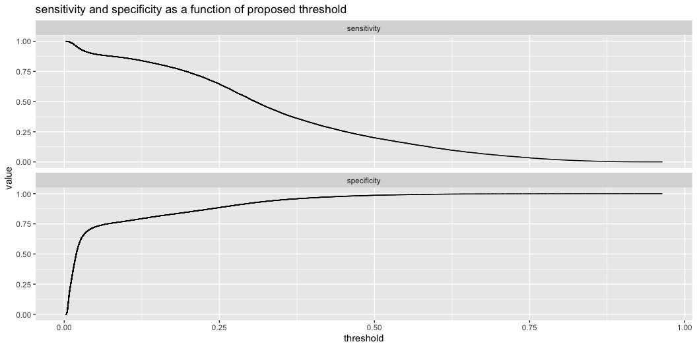
ROC plot
Don’t bother learning the ROC plot until you are comfortable with sensitivity and specificity. All the information in the ROC plot is also in this easy to read plot.
d["prediction"] <- predict(model, newdata = d, type="response") d_expanded <- d[rep(row.names(d), d[["count"]]), ] WVPlots::ThresholdPlot( d_expanded, xvar = "prediction", truthVar = "breast_cancer_history", truth_target = 1, title = "sensitivity and specificity as a function of proposed threshold")

Slide 26
Time to Wrap Up

Slide 27
Summary
Be wary of apply too many or too few tricks in your statistical or data science practice.
You may need some
You should justify each one you use
Statistics is the formal study of when samples correctly represent the population they are drawn from.
Data Science is the optimistic application of machine learning methods at scale.
Or: statisticians like to call summary() and anova(), data scientists are content to call predict().
In either case, the fears of the practitioner don’t always match the fears of the theorist.

Slide 28
Some of our articles on these topics
vtreat for R, vtreat for Python.
Nina Zumel: “I don’t think that means what you think it means;” Statistics to English Translation, Part 1: Accuracy Measures.
Nina Zumel: Does Balancing Classes Improve Classifier Performance?
Nina Zumel: Link Functions versus Data Transforms.
John Mount: Can a classifier that never says “yes” be useful?
John Mount: When Cross-Validation is More Powerful than Regularization.

Slide 29
Thanks

